Slide 1
TASK- 01
Customer sentimental
analysis
Denim cloth of customer sentiment analysis

Slide 2
introduction
Denim is durable, twill-woven fabric typically made from the cotton. Known its rugged texture and versatility, denim is commonly used to create a variety of clothing items , including jeans ,jackets, shirts, skirts .
Originally designed as workwear in 19th century, denim has become a staple in casual and street wear fashion world wide. Its ability to fade and distress over time adds to its appeal, making each piece unique.
Denim is available in various washes and style, ranging from classic blue to black ,white ,and even colored versions, making it a timeless choice in fashion

Slide 3
Customer sentiment review
Customer sentiment analysis help understand how consumers feel about denim cloth products by categorizing feedback into three main types :
POSITIVE SENTIMENT
NEGATIVE SENTIMENT
NEUTRAL SENTIMENT

Slide 4

POSITIVE SENTIMENT
Timeless and always in fashion .
Versatile for casual and formal styles .
Durable and long lasting material .
Unique fades and distressing over time .
Comfortable and breathable for daily wear .
Suitable for all seasons .
Comes in various colours and washes
Easy to pair with other fabrics and styles .

Slide 5

Negative sentiments
Can feel stiff and restrictive initially .
Fades or wears out unevenly over time
Heavyweight fabric can be uncomfortable in hot weather .
Difficult to dry after washing .
May shrink if not cared for properly .
Limited stretch in traditional denim.
Not as environmentally friendly due to production process

Slide 6

Neutral sentiments
Commonly used for jackets , jeans and shirts
Can be customized with patches or embroidery
Ages differently depending on the usage
Requires regular washing for maintenance
Suitable for both casual and semiformal

Slide 7
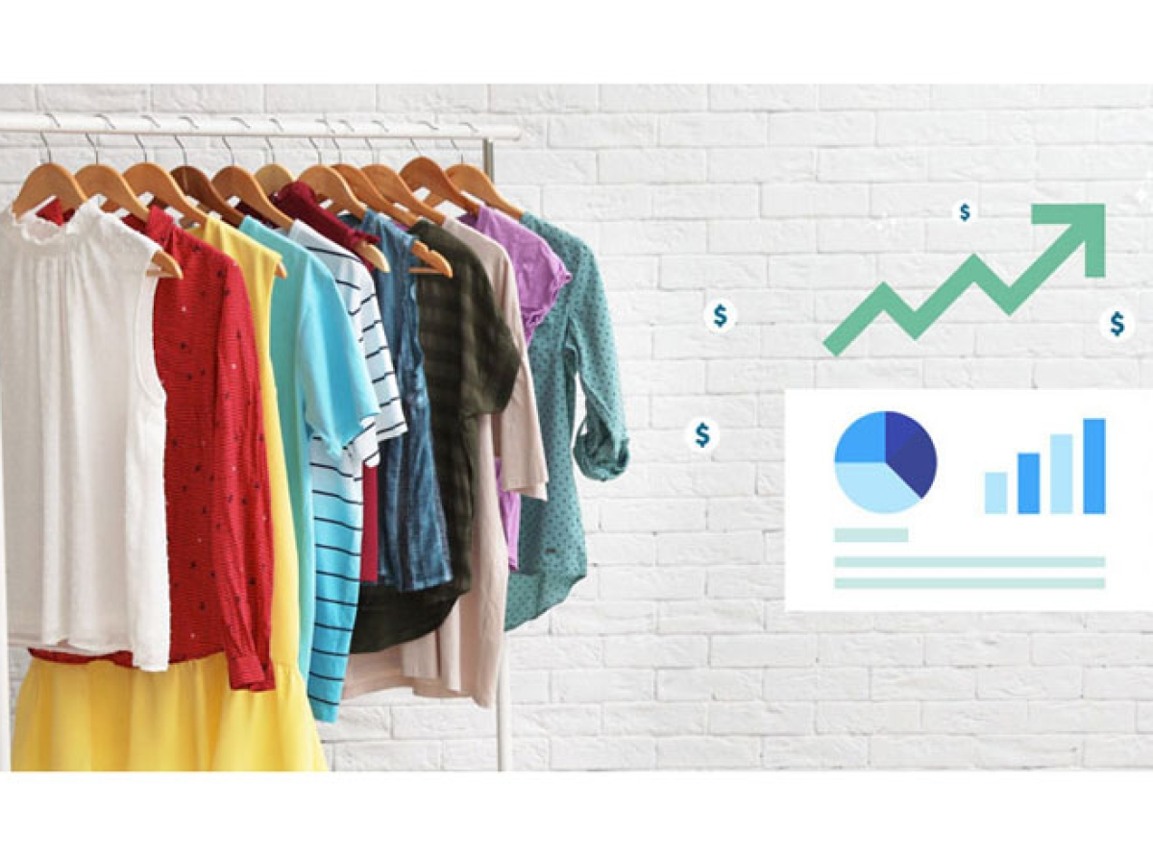
Costumes view e-commerce form platform

Slide 8
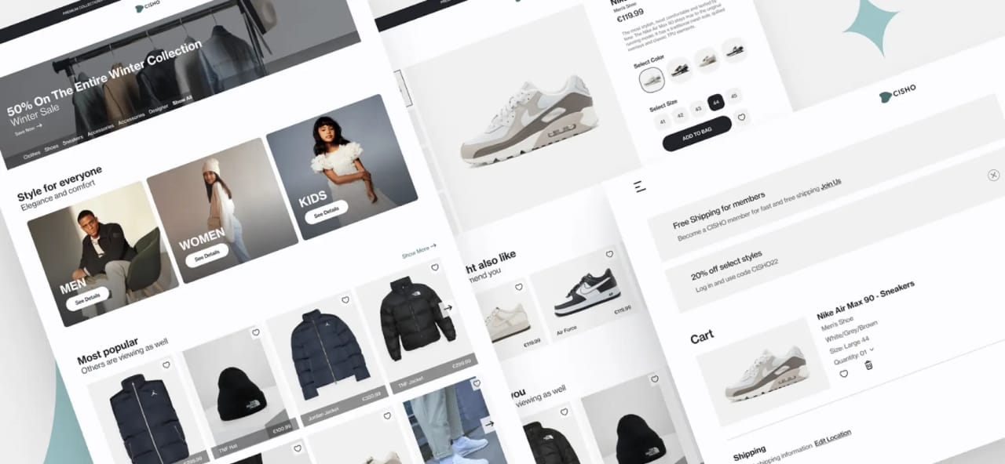
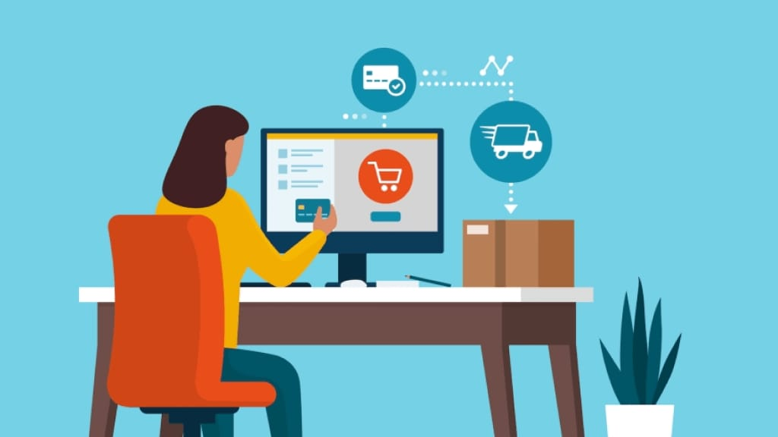

Slide 9
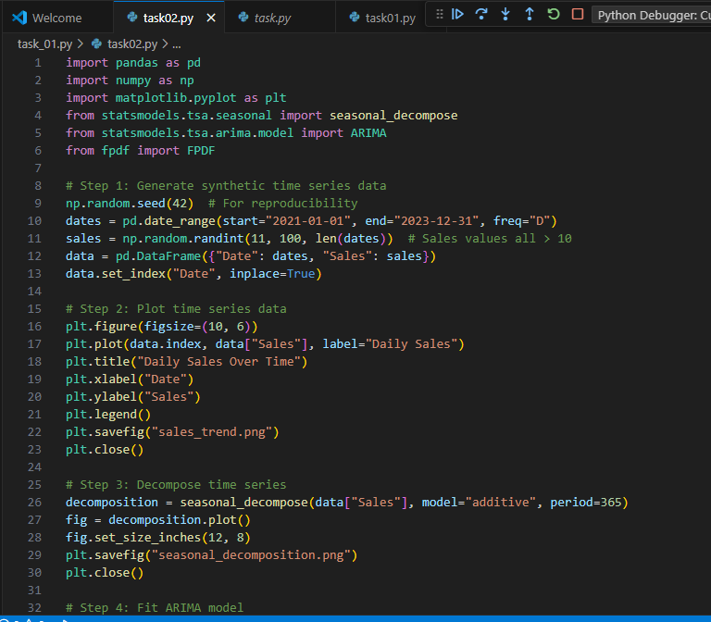
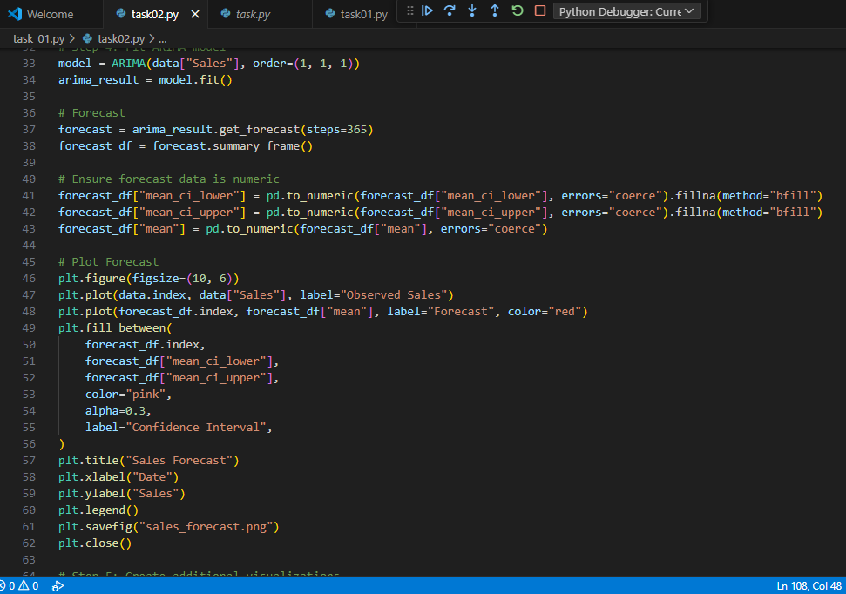
Coding in python

Slide 10
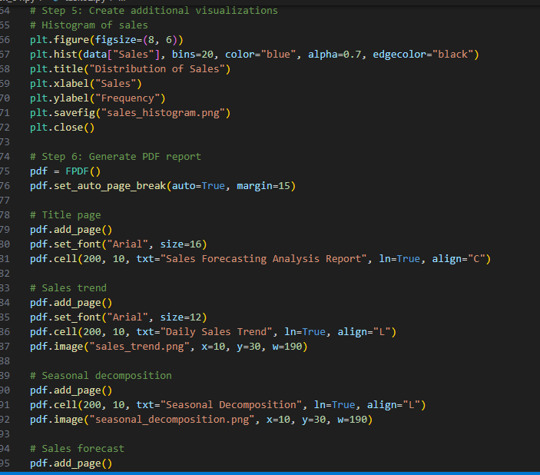
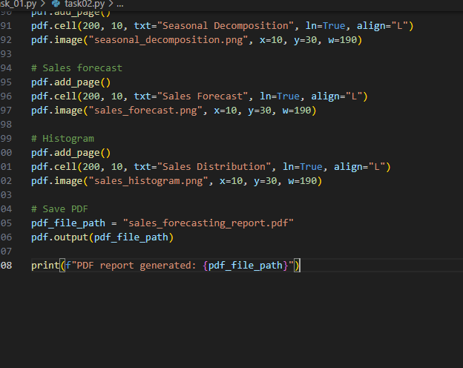
Python code

Slide 11
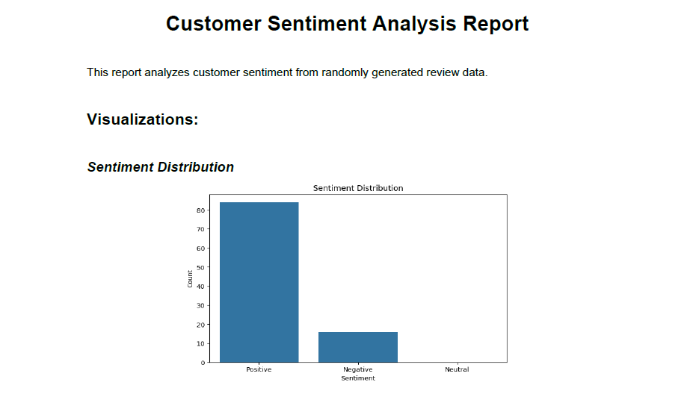
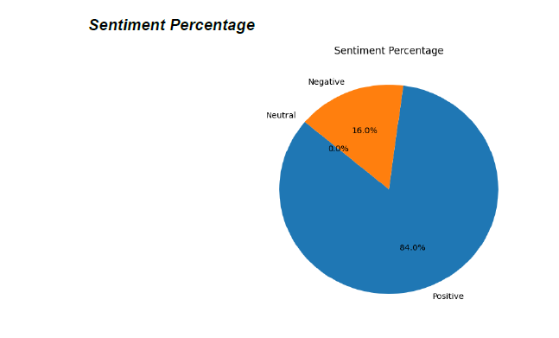
output

Slide 12
